Slide 1
Self-Care as an Ethical Priority
April 26, 2019
By
Jill S. Perry, MS, NCC, LPC, CAADC, SAP

Slide 2
What does COD Look Like?
JP Counseling Healing for Adults, Youth and Families

Slide 3
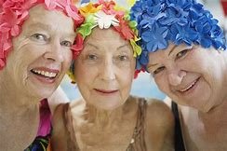
What does COD Look Like?

Slide 4
What does COD Look Like?

Slide 5
Stigma
JP Counseling & Associates, LLC Healing for Adults, Youth and Families

Slide 6
Rules to Eliminate Stigma
DON’T:
Label people who have a mental illness or addiction
Be afraid of people with mental illness or addiction
Use disrespectful terms for people with mental illness or addiction
Be insensitive or blame people with mental illness or addiction
JP Counseling & Associates, LLC Healing for Adults, Youth and Families

Slide 7
Rules to Eliminate Stigma
DON’T:
Label people who have a mental illness or addiction
Be afraid of people with mental illness or addiction
Use disrespectful terms for people with mental illness or addiction
Be insensitive or blame people with mental illness or addiction
JP Counseling & Associates, LLC Healing for Adults, Youth and Families

Slide 8
definitions
Agreed upon rules or standards of practice as established by a profession; conduct deemed as good or right for counselors as a professional group
Refers to a personal belief system
Agreed upon rules in society; less stringent than ethics
Moral Conduct
Ethics
Law

Slide 9
definitions
Tort Law
Malpractice
Slippery slope phenomenon
Area of tort law that holds professionals responsible for harm done to public
Term used to describe what happens when one begins to compromise one’s principles, easier and easier as happens
Law that states a person will be held responsible in court of law if they cause harm to someone

Slide 10
Law vs Ethics vs Best Practices
Laws represent minimum standards
Ethics represent agreed upon professional codes
Best practice is the ideal

Slide 11
Types of Ethics
Virtue Ethics
Aristotle
Believes moral choices made by good judgment not rules
Focuses on principles/traits
Asks ‘who should I be?’
Integrity, discernment, acceptance of emotion, self-awareness, interdependence

Slide 12
Types of Ethics
Relational Ethics
Gilligan
Moral actions are taken in view of relationship to others because of mutual responsibility to one another
Empower people
Promote justice and care for all

Slide 13
Types of Ethics
Principle Ethics
Fidelity
Autonomy
Non-maleficence
Beneficence
Justice
Asks ‘what should I do?’
Notes:
Non-maleficense=to do no harm; beneficence=welfare of person in mind

Slide 14
Types of Ethics
Mandatory Ethics
Lowest threshold for ethical conduct
Keeps one in compliance with minimal standards
Does not meet spirit of law

Slide 15
Types of Ethics
Aspirational Ethics
Highest moral conduct
Closely related to best practice

Slide 16
Why Do We Need Ethics
Situations are evolving
Society changes
Technology
Research

Slide 17
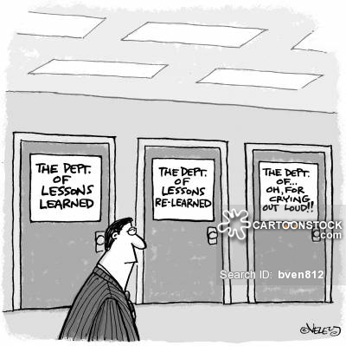

Slide 18
Me: Defined

Slide 19
Me: Defined
What is it about you that led you toward helping others?
What are the values that you will never compromise in your work with clients?
What are you committed to offer clients? What are you committed to offer yourself?

Slide 20
Me: Defined
What do you believe about your clients? What about your own strengths?
If you were to become your ideal counselor, what would that look like to you?
What impediments keep you from this ideal?

Slide 21
Privacy, Confidentiality & Privilege
These terms have narrow legal meanings quite distinct from the broader traditional meanings attached by mental health practitioners.

Slide 22
Privacy, Confidentiality & Privilege
Many difficulties link to a failure on the part of professionals to discriminate among the different terms and meanings.
Still other dilemmas stem from the fact that legal obligations do not always align with ethical responsibilities.

Slide 23
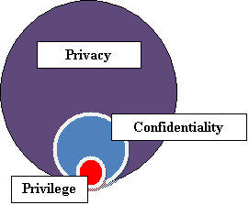
PRIVELEGE, CONFIDENTIALTY & PRIVACY

Slide 24
Privacy
Involves the basic entitlement of people to decide how much of their property, thoughts, feelings, or personal data to share with others.
In this sense, privacy seems essential to ensure human dignity and freedom of self-determination.

Slide 25
Confidentiality
Refers to a general standard of professional conduct that obliges a professional not to discuss information about a client with anyone
Confidentiality may also originate in statutes (i.e., laws enacted by legislatures), administrative law (i.e., regulations promulgated to implement legislation), or case law (i.e., interpretations of laws by courts).

Slide 26
Confidentiality
When cited as an ethical principle, confidentiality implies an explicit contract or promise not to reveal anything about a client except under certain circumstances agreed to by both parties.

Slide 27
Privilege or Privileged Communication
Describes certain specific types of relationships that enjoy protection from disclosure in legal proceedings.
Designation of privilege originates in statute or case law and belongs to the client in the relationship.

Slide 28
Occupational Risks

Slide 29
Where Do the Stories Go at the End of the Day?

Slide 30
Occupational Risks
Charles Figley (1995): ‘…there is a cost to caring…the most effective therapists are most vulnerable to this contagion effect…those who have enormous capacity for feeling and expressing empathy tend to be more at risk of compassion stress…’
Our inner reserves of empathy aren’t infinite

Slide 31
Occupational Risks
Leading traumatologist Eric Gentry suggests that people who are attracted to caregiving often enter the field already compassion fatigued. A strong identification with helpless, suffering, or traumatized people or animals is possibly the motive.
It is common for such people to hail from a tradition of what Gentry labels: other-directed care giving. Simply put, these are people who were taught at an early age to care for the needs of others before caring for their own needs.

Slide 32
Occupational Risks
Psychological principles, methods and research are applied rarely to therapists themselves. It’s interesting that we help clients to change in ways we don’t always practice ourselves.
There is a lack of systematic study on therapists and self-care.

Slide 33
Occupational Risk
It appears that counselors and therapists feel great shame around being impaired by our work.
This is unrealistic given a growing body of empirical research attesting to the negative toll exacted by a career in counseling, as well as the effects of compassion fatigue.

Slide 34
Occupational Risks
Empirical research attests to the negative toll exacted by a career in therapy, including:
Depression
Mild anxiety
Emotional exhaustion
Disrupted relationships

Slide 35
Occupational Risks
The imperatives of confidentiality, the realities of isolation, and the shame felt when we experience the negative impact of our work, along with a host of other considerations, lead us to overpersonalize our own sources of stress, when in fact they are a given in psychological work

Slide 36
Occupational Risks
Current policies in relation to distressed and impaired practitioners tend to be inconsistent and incomplete, and focus on code enforcement rather than on prevention efforts.
It is difficult to estimate the overall prevalence of burnout in counselors and therapists as unknown numbers leave the profession, or move towards teaching and administration rather than frontline therapy.

Slide 37
“That which is to give light must endure burning.” ----Victor Frankl

Slide 38
Self-Compassion Quiz

Slide 39
Secondary Trauma
The stress from helping or wanting to help a traumatized or suffering person
Also known as Compassion fatigue

Slide 40
Secondary or vicarious trauma or compassion fatique
May occur when issues clients bring to us are similar to issues we may have encountered in our lives.
May occur when issues clients bring to us begin to exhaust our ability to work effectively.

Slide 41
Signs may include any of the following:
Flashbacks (about our own issues/experiences)
Triggers / buttons that a client may push (about which we are sensitive)
Beliefs we have that are challenged by our clients
Nervous system arousal (Sleep disturbance)
Emotional intensity increases
Cognitive ability decreases

Slide 42
Behavior and judgment impaired
Avoidance / denial / isolation (you may begin to blame the ‘victim’)
Re-opening of “old wounds”
Nightmares (perhaps about something a client has shared or we have witnessed involving a client)
Guilt, shame, rage
Unsuccessful at separating professional work from personal life
Becoming fearful of a client (personal safety)

Slide 43
Daydreams / re-enactments about a client’s issues (or our own which have been stirred up by client)
Adrenaline rushes
Feeling unfulfilled by your work or feeling you are unsuccessful in helping clients
Zoning out (particularly during client-contact time)
Sleepy / trance-like behavior
Personal depression
Feeling estranged from others

Slide 44
-Overworking yourself
Physical symptoms: sleeplessness, appetite decrease or increase, panic or anxiety attacks, hyper vigilance, hyper alert – easily startled
Loss of self-worth and emotional modulation
Identity, worldview, and spirituality impacted
Beliefs and psychological needs-safety, trust, esteem, intimacy, and control
Loss of hope and meaning=existential despair
Anger toward perpetrators or causal events

Slide 45
Different from burn-out
Burn-out is more related to the day-to-day stressors of the job, whereas secondary or vicarious trauma or compassion fatigue are directly related to what we absorb from our clients’ material.
Secondary traumatic stress is distinguished from burnout by its rapid onset and the extent to which the affected therapist presents with similar symptoms to those affected by post traumatic stress disorder.

Slide 46
Burn-out
Conscious burnout drains us
Unconscious burnout is often taken out on the people we love

Slide 47
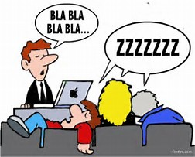
Silencing Response Scale

Slide 48
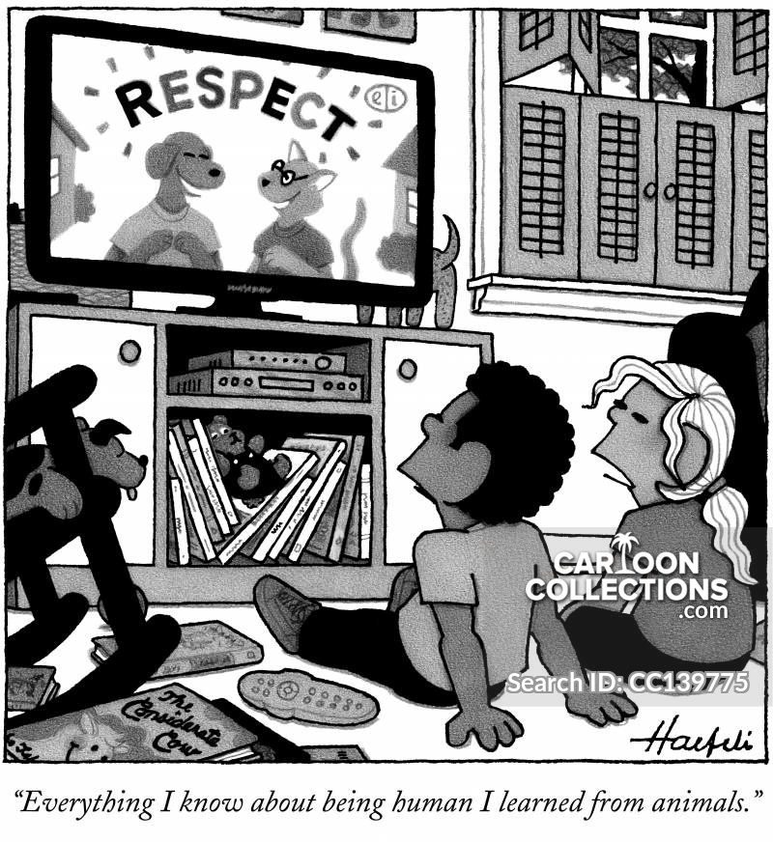

Slide 49
4 Self-Tests of Decision of Ethical Dilemma
Justice (would I treat others this way)
Universality (would I recommend)
Publicity (would I publicize)
Moral Traces

Slide 50
Dilemma Tree

Slide 51
Ethical Issues

Slide 52
Self-Disclosure
Self-disclosure in psychotherapy is defined as the revelation of personal rather than professional information by a psychotherapist to a client.
All disclosures reflect decisions about the boundaries between the private self and the outer world.

Slide 53
Self-Disclosure
Intentional or Unintentional
Verbal or Nonverbal
Avoidable or Unavoidable

Slide 54
Self-Disclosure
BENIGN
APPROPRIATE
INAPPROPRIATE

Slide 55
Problems with Counselor Self Disclosure
Lost focus (e.g., disclosures that divert the interview from the experience of the client to the experience of the counselor)
Inappropriate timing (e.g., disclosures that slow the development of or abort the therapeutic relationship)

Slide 56
Problems with Counselor Self Disclosure
Duration(e.g., disclosures of excessive length that constitute a form of introspective disengagement on the part of the counselor)
Immediacy (e.g., communicating current experiences from the counselor’s personal life about which the counselor lacks objectivity and emotional control)

Slide 57
A New Spin on Self-Disclosure

Slide 58
A New Spin on Self-Disclosure
The Internet has redefined the process of self-disclosure.
Even when a counselor creates concrete guidelines for himself around the area of self-disclosure, the Internet can potentially counteract even the best of those intentions.
Interesting professional and ethical challenges increase as the distinctions between private and public information blurs

Slide 59
A New Spin on Self-Disclosure
Nothing that enters cyberspace is ever completely secure
Clinicians must be aware that all their online postings, blogs, or chats may be viewed by their clients and will stay online, in some form, forever
A few study participants even reported that they had been matched to current or former clients through anonymous dating Web sites.

Slide 60
Questions to Ask Yourself Before Posting
What are the costs and benefits of posting the information?
Is there a high probability that clients will be significantly and negatively affected?

Slide 61
Questions to Ask Yourself Before Posting
How will the disclosure affect my relationship with my clients?
Does the disclosure threaten my credibility or undermine the public’s trust in the field of counseling?

Slide 62
Email/TEXT Clients
Email/Text communication must support the working alliance between the counselor and client and promote trust
Administrative emails/texts would include date, and time of next appointment, cancellation of appointments, rescheduling appointments, etc.
Counseling emails/texts include therapeutic material regarding clients’ problems and issues

Slide 63
Confidentiality and Privacy
Counselors Must:
1. Acknowledge that email or text correspondence is not confidential
2. Determine what information will be okay to disclose in an email or text
3. Determine the policy for recording the email or text in the client record
5. Ask the client about the privacy of their email or text account and who has access

Slide 64
Email/Text Issues
What policy has the counselor communicated to the client regarding how frequently they check email or text.
Every e-mail sent to a client should contain a signature that includes information about such issues as:
Confidentiality --Security
--Privacy --Unauthorized Access
Intended User

Slide 65
Email/Text Issues
For example: ‘‘This e-mail and any attachments are intended only for use by the addressee and may also contain privileged or confidential information”

Slide 66
Sexual & Dual Relationship
Greatest number of malpractice suits involve client-counselor sexual relationships
Counselor is in a position of power over the client by virtue of the position
The counselor is always responsible to prevent these relationships

Slide 67
Sexual & Dual Relationship
Friendships or other relationships
Use caution
Can it cause harm to the client?
Inappropriate levels of intimacy (e.g., excessively intimate disclosures that diminish a client’s feelings of physical and psychological safety in the service relationship or diminish the client’s confidence in the abilities of the counselor)
Cultural violation (e.g., disclosures that violate cultural etiquette)

Slide 68
Sexual & Dual Relationship
Should a counselor have the same policy regarding their online interactions for everyone?
Or should the decision of whether, for example, to “friend” a client on a social networking site be made individually, depending on the function for that particular client.

Slide 69
Patient “Googling”
The accessibility, anonymity, and universality of the Internet have made it easier and more tempting to “Google” clients
Patient Targeted Googling: Is it infringing on a patient’s privacy?

Slide 70
Patient “Googling”
Consider the intention of the search
Evaluate the potential risk to the patient
Anticipate the effect of gaining previously unknown information

Slide 71
Patient “Googling”
Why Do I Want to Conduct This Search?
Would My Search Advance or Compromise the Treatment?
Should I Obtain Informed Consent from the Patient Prior to Searching?

Slide 72
Patient “Googling”
Should I Share the Results of the Search with the Patient?
Should I Document the Findings of the Search in the Medical Record?
How Do I Monitor My Motivations and the Ongoing Risk-Benefit Profile of Searching?

Slide 73
Counter-transference
Counselor projects feelings and attitudes that distort the way he or she perceives a client
Influenced by the counselor’s own past experiences
Can be a helpful tool but must be kept in check

Slide 74
Financial Issues
Co-pay, deductibles, co-insurance
Sliding Scale
Write-offs
Lending Money

Slide 75
debate
1. Those taking the position that treatment programs have a right to discharge clients for drinking or using while in the program.
2. Those taking the position that treatment programs owe a duty of care to those who cannot or will not maintain sobriety during the treatment.

Slide 76
debate
1. Discuss the ethical issues involved if you believe a colleague is experiencing impairment at work. Do you have a responsibility to address the situation? How would you handle it?
2. What are the ethical considerations that arise with mandatory reporting policies/laws?
3. What are the ethical considerations that arise with mandated treatment?
4. What are the ethical issues connected to the following statement, “If an older person has a drinking problem, really, what’s the harm? Maybe in their old age, we should just let them enjoy their drinking with what time they have left.”

Slide 77
dilemnas

Slide 78
ProQOL

Slide 79
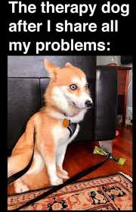

Slide 80
Prevention
Painful symptoms can be a blessing. They point out to the caregiver that his life is out of balance and needing intervention
For the field to retain motivated, competent professionals, training and education program need to emphasize balance, integration of work with the rest of life, and the spiritual and transcendent nature of therapy.

Slide 81
Prevention
Prevention is better than cure. Studies of those who have managed with success to navigate years of working with distressed clients can be of vital assistance to the field.
Common themes have been identified in therapists who function well and their self-care methods. Recognition of and emphasis on these common themes are needed in training and continuing professional development.

Slide 82
Prevention
The key to prevention of compassion fatique lies in the establishment of a professional ethos in which self-care is viewed as a moral imperative.
In such a scenario, self-care would be stressed as a priority in our work as counselors by training bodies as well as professional organizations.
Self-care strategies would be included in the training and on-going maintenance regimes of therapists.

Slide 83
The ABC’s of Prevention of Compassion Fatique
A = Awareness
B = Balance
C = Connections

Slide 84
A = Awareness of Issues & Contributing Factors
What types of cases contribute to your stress level increasing your vulnerability to compassion fatigue?
What type of events or situations cause you to experience an unusually strong reaction, often overpowering your usual coping mechanisms

Slide 85
A = Awareness of Issues & Contributing Factors
Awareness of symptoms:
Ability to function is interfered with or altered.
Situation or incident does not seem “typical or ordinary”, it feels traumatic.
“Compassion stress” impinges upon or breaks through normal boundaries
Regularly waking up tired in the morning and struggling to get to work?

Slide 86
A = Awareness of Issues & Contributing Factors
Feeling as if you are working harder but accomplishing less?
Becoming frustrated/irritated easily?
Losing compassion for some people while becoming over involved in others?
Routinely feeling bored or disgusted?
Experiencing illness, aches and pains?

Slide 87
A = Awareness of Issues & Contributing Factors
If you experience any of the above signs or symptoms, realize that you are not alone and that secondary trauma and compassion fatigue are treatable.
Work to establish and maintain a healthy balance between your professional work and personal life.

Slide 88
A = Awareness of Issues & Contributing Factors
Make a concerted effort to keep your body, mind, and health in good shape by eating well and getting plenty of sleep.
Another important part of therapist self-care is to engage in our own personal therapeutic process in addition to the supervision process that is part of our work. Being a therapist in therapy is a good thing.

Slide 89
Even Mother Teresa Understood Compassion Fatique
Wrote in her plan to her superiors that it was MANDATORY for her nuns to take an entire year off from their duties every 4-5 years to allow them to heal from the effects of their care-giving work.

Slide 90
B = Balance In Your Life
Emotions are a signal that tell us when something is wrong or we are out of balance
We all need meaning and purpose in our life
We all need autonomy and freedom to make choices that bring us balance and happiness
We all have hidden sources of energy and healing power.

Slide 91
B = Balance In Your Life
When you identify the things that fuel you, the things that you have true passion for, your fatigue will disappear.
Balancing your life involves putting the things that we value and have passion for in our schedule.
Listen to what we Tell our Clients

Slide 92
B = Balance In Your Life
Practice excellent self-care
Nurture yourself by putting activities in your schedule that are sources of pleasure, joy and diversion
Allow yourself to take mini-escapes- these relieve the intensity of your work

Slide 93
B = Balance In Your Life
Transform the negative impact of your work (find meaning, challenge negativity, find gratitude)
Get medical treatment if needed to relieve symptoms that interfere with daily functioning- don’t use alcohol or drugs to self-medicate
Get professional help when needed to get back on track- we all need coaches and consultants at times

Slide 94
B = Balance In Your Life
Have quiet alone time in a calm, beautiful place- a safe retreat where you feel renewed
Have an awareness of what restores and replenishes you
Find ways to acknowledge loss and grief

Slide 95
B = Balance In Your Life
Stay clear with commitment to career goals or your personal mission
Know how to focus on what you can control
Look at situations as entertaining challenges and opportunities, not problems or stresses

Slide 96
B = Balance In Your Life
In the Interest of Self-Care, It Is Important to Remember that Balance
Is especially important given our unique occupational vulnerabilities
Enables us to be more present and effective with our clients
Encourages more rewards in all aspects of our lives.

Slide 97
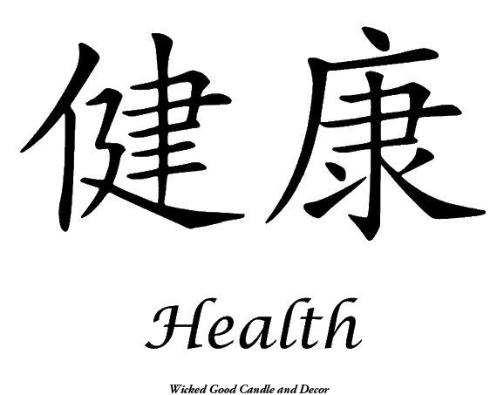
Chinese Proverb
Equation for the value of your life
Your Health = 1
Everything else = 0
Without your health, you have nothing.

Slide 98
B = Balance In Your Life
Exercise
Relax-Breathe
Get adequate sleep
Good nutrition and water
Good medical and preventative care

Slide 99
C = Connections
Talk out your stress- process your thoughts and reactions with someone else (coworker, therapist, clergy, friend, family, supervisor)
Build a positive support system that supports you, not fuels your stress

Slide 100
C = Connections
Pets accept whatever affection you are able to give them without asking for more---Pets are basically invulnerable to “provider burnout”--Blood pressure and heart rate decrease when interacting with animals

Slide 101
C = Connections
In addition to the above, one of the most important things we can do is maintain connections with our colleagues.
Connecting with colleagues on a regular basis can lessen the isolation often experienced in independent practice.
Peer mentoring provides reciprocal support and time to discuss and share vulnerabilities and successes.

Slide 102
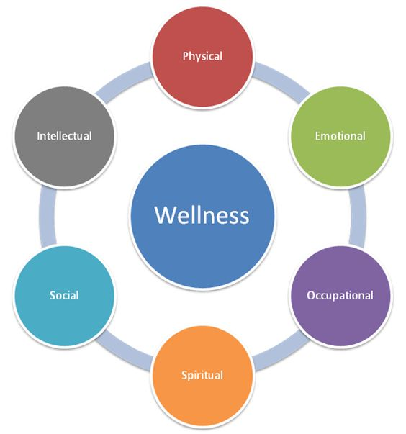

Slide 103
Ways to Avoid Compassion Fatique
Have a manageable patient load, know and set boundaries and limits.
Use a team approach with patients whenever possible.
Take a “Mental Health Day” when needed.

Slide 104
Ways to Avoid Compassion Fatique
Laugh, joke, have time to unwind.
Have a holistic approach to taking care of myself – mind, body, feelings, spirituality. Let go, do not allow stress or take on others’ stress, reduce anxiety, recognize choices.

Slide 105
Ways to Avoid Compassion Fatique
Have an understanding supervisor.
Have supervision with supervisor and peers.
Get and give feedback with supervisor and peers.
Read materials and go to workshops and training seminars related to compassion fatigue.
Be assertive with feelings and concerns.

Slide 106
Ways to Avoid Compassion Fatique
Let people know your limits.
Process, talk things out. Talk to a health care professional if needed.
Have a safe work environment.
Stay organized.

Slide 107
Ways to Avoid Compassion Fatique
Assess and readjust your caseload.
Set healthy boundaries for yourself and the clients you serve.
Vary professional activities to prevent isolation and burnout.
Consider occasional self-assessments to gauge your own level of well-being

Slide 108
Self-Care outcomes
High levels of personal accomplishment
General well-being
Enhanced self-awareness
Openness to experience
Appreciation of the rewards of care-giving
which all led to increased job satisfaction

Slide 109
Self-Care themes
Self-awareness and self-monitoring, which requires attention to interpersonal feedback from significant others
Support from peers, spouses, friends, mentors, therapists and supervisors

Slide 110
Self-Care themes
Personal values that help the practitioner to observe ethical standards of practice
A balanced life that incorporates vacations and stress-reducers, and continuing education to ensure that the practitioner diversifies their work and keeps abreast of changes

Slide 111
Self-Care themes
Embracing multiple strategies for self-care. Studies suggest that possession of one particular skill is less valuable than a variety of self-care skills.
Other researchers, some of whom incorporated cross-cultural studies on the impact of meditation and mindfulness, found empirical evidence that these methods show a marked influence on general well-being.

Slide 112
Self-Care themes
Diversity and synergy of professional activities such as:
conducting multiple forms of therapy (individual, couples, group)
engaging in a range of activities (e.g. therapy, assessment, research, teaching, supervision, consultation)
work with a variety of clients and problems (age, ethnicity, disorders)
continuing education
balancing professional responsibilities with personal needs

Slide 113
How You Can Practice Self-Care
Identify what activities help you feel your best. Self-care is individual, and self-care for one person will mean something completely different for someone else. One person may need more alone time, for example, while another may nurture herself by spending more time out with friends.

Slide 114
How You Can Practice Self-Care
Put it on your calendar — in ink! Take a close look at your calendar and carve out one or two hours for self-care and stick to it. This may take extra prep, but it’s worth it. For example, the mornings may be the best time for you to exercise, so at night, lay out your workout and professional gear and anything else you needs for the day.

Slide 115
How You Can Practice Self-Care
Sneak in self-care where you can. If you don’t have huge chunks of time, you can still fit in little moments of relaxation. Don’t wait to add self-care to your life until your schedule frees up. Start where you are.
Even if you take just five minutes to close your eyes and take a few deep breaths, it can help your stress level. Or A 10-minute walk makes a big difference.
Don’t hesitate to get creative either. Some may use their time between client appointments to listen to music, dance or read.

Slide 116
How You Can Practice Self-Care
Know when to say no. “Your health and well-being come first.”
Take care of yourself physically.
Sleep, eating nutritious foods and exercising.
When you physically take care of yourself, you will reap the benefits emotionally, psychologically, health-wise, and in your relationships.

Slide 117
How You Can Practice Self-Care
Check in with yourself regularly. Ask yourself the following critical questions: “Are you working too much? Do you feel tapped out? What do you need to take away, and what would you like to add?”
Surround yourself with great people. Make sure that the people in your life are upbeat, positive and know how to enjoy life.

Slide 118
How You Can Practice Self-Care
Consider the quality of self-care. Go for quality, especially when the quantity is lacking.
Remember that self-care is non-negotiable.

Slide 119
How You Can Practice Self-Care
Research showed that ‘passionately committed psychotherapists’ experienced a strong sense of spirituality. They found that an interest in activities unrelated to work as therapists, and attention to spiritual disciplines and development were as crucial, if not more crucial, than the pursuit of professional avenues of achievement.

Slide 120
How You Can Practice Self-Care
Research on the regular use of spiritual practice, in particular meditation, has shown the following benefits:
Provision of meaning frameworks for the human condition
Beneficial effects on the physical, emotional, mental and spiritual aspects of being
Provision of social support networks and relationships
Clarification and development of personal values and ethics
Enhancement of the capacities of self-awareness
Self-monitoring and altruism
The capacity to act on these in a realistic manner

Slide 121
How You Can Practice Self-Care
Don’t go it alone
Prevention of isolation requires that we have a sense of community – be it through a peer group, supervision, attendance at conferences and so on. In addition, we need a sense of belonging through family, friends, hobbies and other means to ensure that we have a sense of self that is not just based on our occupation

Slide 122
How You Can Practice Self-Care
”Maintain beginner’s mind” Cultivate passionate involvement in learning something new, such as a hobby, a sport, a new discipline, a language, a new therapeutic model and so on. No matter how experienced and knowledgeable we are, it is always good to have a teacher of some sort as a way to be nurtured and to stay ‘open’.
Remember to let our clients teach us – they are the experts in their own lives.

Slide 123
How You Can Practice Self-Care
Prioritize
‘Voluntary simplicity involves both an inner and outer condition. It means singleness of purpose, sincerity and honesty within, as well as avoidance of exterior clutter, of many possessions irrelevant to the chief purpose of life. It means an ordering and guiding of our energy and our desires, a partial restraint in some direction in order to secure greater abundance of life in other directions. It involves a deliberate organization of life for a purpose…’
Richard Gregg

Slide 124
How You Can Practice Self-Care
You Are Not IT
All we require in order to have the healing presence of a Higher Power in our life is to know that we are not it!
Stop For a Refill
We need to be mindful of numbing out activities that don’t replenish and restore us. Utilize alternatives like exercise, healthy eating and sufficient sleep, plus hobbies that give a genuine recharge. Find your own methods, such as affirmations, prayer, massage, yoga, journaling, support groups, spiritual direction or meditation and use them regularly.

Slide 125
Meditation
Compared the brains of 22 meditators and 22 age-matched nonmeditators and found that the meditators (who practiced a wide range of traditions and had between 5 and 46 years of meditation experience) had more gray matter in regions of the brain that are important for attention, emotion regulation, and mental flexibility.

Slide 126
Meditation
Increased gray matter typically makes an area of the brain more efficient or powerful at processing information. This increased gray matter in the meditators' brains should make them better at controlling their attention, managing their emotions, and making mindful choices.

Slide 127
Meditation
More and more neuroscientists have started to think that learning to meditate is no different from learning mental skills such as music or math. Like anything else that requires practice, meditation is a training program for the brain.
Regular use may strengthen the connections between neurons and can also make new connections. These tiny changes, in thousands of connections, can lead to visible changes in the structure of the brain.

Slide 128
Loving/Kindness meditation

Slide 129
Mindfulness is not trying to relax
Modern scientific psychology considers mindfulness to be a core factor in healing and general well-being.

Slide 130
Mindfulness is not about transcending ordinary life
Mindfulness is making intimate contact with each moment of our lives, no matter how “small” it may be. Simple things can become very special. Extraordinary “ordinary” experiences becomes more available.

Slide 131
Mindfulness is not difficult
It is not necessary to feel discouraged when you discover that your mind wanders incessantly. That is the nature of the mind. It is also the nature of the mind to become aware that it is wandering. Mindfulness develops the ability to step back and witness thoughts and feelings without being “hijacked” by them. This is called Metacognition. It is not possible to do mindfulness perfectly. Nor, is it possible to fail. That is why it is called a “practice”. Over time it can lead to a more balanced sense of well-being. Mindfulness is natural.

Slide 132
Mindfulness is not about emptying the mind of thoughts
The brain will always produce thoughts. That is what it does. Mindfulness allows us to develop a more harmonious relationship with our thoughts and feelings through a deeper understanding of how the mind works. It may feel like we have fewer thoughts; because we are not struggling with them so much.

Slide 133
Mindfulness is not an escape from pain
This is often challenging to understand and accept. Because, we typically do things to feel better. Or, to escape from pain. Mindfulness can change a person’s relationship with pain. This shift can reduce the resistance and fear that frequently cause a great increase in our experience of “suffering”. Pain is like an angry bull. When it is confined in a tight stall, it will be wild and try to escape. When it is in an open field, it will calm down. Mindfulness makes emotional space for pain. It can enable it to be experienced in a larger context.

Slide 134
Mindfulness is not a religion
Any intentional activity that increases moment-to-moment awareness is a mindfulness exercise. We can practice mindfulness as part of religion; or not.

Slide 135
“Hope does not take away your problems. It can lift you above them.” --Maya Angelou

