Slide 1
Zero Suicide Team Leaders
Beaver County
6/17/2022

Slide 2
Today’s Agenda
Minutes
Partner Updates
Marketing and Community Outreach Team
Trainings
Next Meeting
Resources

Slide 3
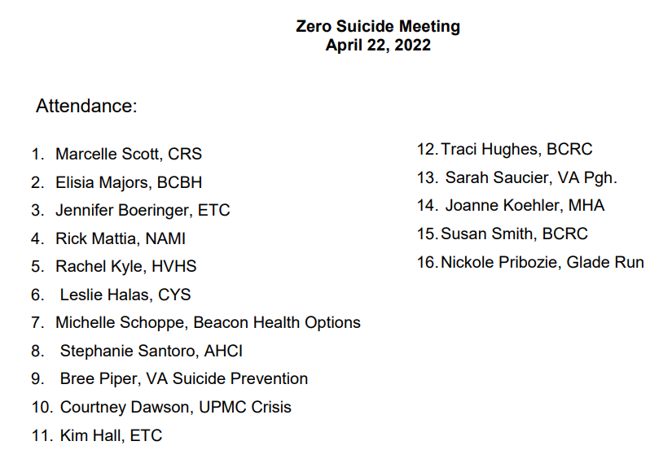
04.22.22 PowerPoint
http://www.bc-systemofcare.org/zero-suicide/
Please use this PowerPoint as the minutes from last meeting

Slide 4
PARTNER UPDATES

Slide 5
Beaver County Bounces Back Video

Slide 6
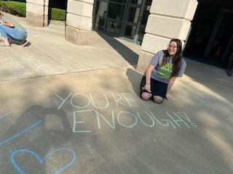
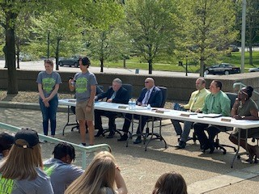
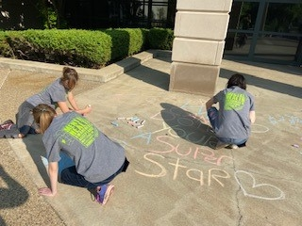
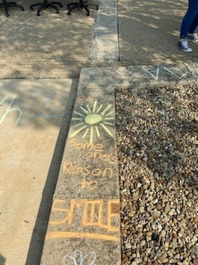
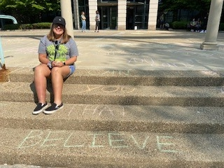
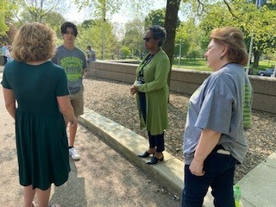
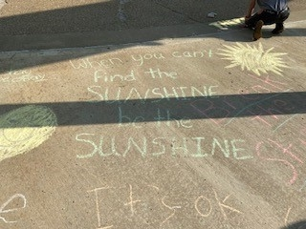
Youth Ambassador Program Video at the Beaver County Courthouse

Slide 7
American Foundation for Suicide Prevention
Upcoming events:
Talk Saves Lives for Firearms Owners on June 23rd.
It’s Ok to have the Blues
More information can be found at https://afsp.org/westernpa
Lawrence County Out of the Darkness Walk on September 17th. register at https://afsp.org/newcastle.
If people are interested in attending, sponsoring, or tabling, email Michele Kelly-Thompson at mkthompson@humanservicescenter.net

Slide 8
July 11th

Slide 9
Beaver County Unity Games Saturday July 16th at CCBC (Baseball Field)
Hosted by the BEAVER COUNTY COMMUNITY AND LAW ENFORCEMENT COALITION (BCCLEC)
Participants Grades 8-12
Law Enforcement/First Responders
Family Friendly and all are welcome!
Free Admission
Food & Prizes
For details, to VIEW/PRINT/SHARE the Flyer, and to Register, visit:
https://www.bc-systemofcare.org/unity-vigil-and-unity-games/

Slide 10
Other Updates

Slide 11
Beacon Health Options 2022 TAAG Picnic
All youth 16-30 are invited to attend as well as those who are transporting youth or young adults to the picnic. Youth under the age of 18 must be accompanied by an adult over the age of 21.
Download this Flyer / Registration Form at: https://www.bc-systemofcare.org/2022-taag-picnics-western-pa/

Slide 12
School Emergency Symposiums
July 19th and 26th from 8:30–4:30 at the BVIU. You need attend only one session!
Capacity for each session is 200. RSVP using the link below or scan code. Food truck lunch.
To RSVP:
https://forms.gle/SVBhVfEikfHEGNX1A

Slide 13
RELEASED JUNE 7TH, 2022: Outpatient Mental Health and Substance Use Disorder Treatment Services in Schools: Considerations for Schools and Providers
"This document is focused on providing guidance to improve communication and collaboration between schools and providers of outpatient treatment (mental health and/or drug and alcohol) delivered in school settings.
The document places emphasis on the SAP process and how it can be used to improve these partnerships.

Slide 14
Marketing and Community Outreach and Education Team
Planning a Town Hall Event for September (Recovery Month)
x
x
x
Want to join the committee?
Contact Marcy Scott mscott@crscares.org or Elisia Majors emajors@bcbh.org

Slide 15
www/bc-systemofcare.org Announcements!
Unity Vigil on July 11th & Unity Games on July 16th from 9–12 | Making LBGTQ+ Mental Health a priority during and beyond Pride Month this June | HealthChoices Young Adults ages 16-30, REGISTER NOW for YOUR closest TAAG Picnic! | Parent, Teacher and Caregiver resources following a Traumatic Event
SMI Advisor offers FREE on-demand courses in crisis care with practical, evidence-based strategies | 2022 Beaver County Community Forum | June 20th | Why Mattering Matters: The importance of mattering for people with mental illness | Beacon Health Options 2022 Virtual Member & Family Training Series
The SOC website will not be available on Thursday 6/23 due to scheduled maintenance.
eSP won’t be accessible through the website on 6/23. Matt Koren will email the eSP users how to access it directly.

Slide 16
TRAININGS

Slide 17
Wrapping up the Co-Occurring Disorder Series with Jill Perry . . .
6/29/2022 FROM 9AM-12PM
ANOTHER LOOK AT SPECIAL POPULATIONS: WOMEN, OLDER ADULTS, AND LGBTQIA+
Understanding the generalities of co-occurring disorders is not enough. Community workers in various settings must also be aware of how sub-cultures are impacted in different ways. This advanced training will cover a review of special concerns regarding women, older adults, and the LGBTQIA+ community.
For registration and details, visit https://www.bc-systemofcare.org/training/

Slide 18
NEW!

Slide 19
NEW!
For registration and details, visit https://www.bc-systemofcare.org/training/

Slide 20
Mental Health Partnerships is offering FREE Continuing Education Courses for Peers who work or reside in Pennsylvania!
NEW!
*
Ethics and Boundaries July 12, 2022 9:00am-12:00pm
_____________________________________________________________
Part 2: Understanding Youth Suicidality July 20, 2022 9:00am-12:00pm
Trauma-Informed De-Escalation August 4, 2022 9:00am-11:00am
For registration and details, visit the bottom of webpage: https://www.bc-systemofcare.org/peer-supports/
(Fulfills the 3-hr CE requirement to maintain a CPS certification in PA.)

Slide 21
Save the Dates: July 26th and Sept. 27th

Slide 22
Trainings Available
QPR (Question, Persuade, and Refer)
Virtual or In-person
Youth QPR (Question, Persuade, and Refer)
Virtual or In-person
Mental Health First Aid
Youth Mental Health First Aid
Archived trainings:
BC SOC Youtube:
https://www.youtube.com/channel/UCDKZZQif0q0YIqfBgkEGc4Q
Beacon:
https://www.beaconhealthoptions.com/providers/beacon/important-tools/webinars/archive/
Prevent Suicide PA:
https://www.preventsuicidepa.org/trainings/all-trainings/
www.bc-systemofcare.org/training/

Slide 23
Next meeting
Date: _______ at 1:30pm
Zoom link will be sent

Slide 24
Check out the website: http://www.bc-systemofcare.org/ Send updates to: SOCwebmaster@ahci.org SOC YouTube channel: https://www.youtube.com/watch?v=GY4rLQJRAcM&list=PL6lF8gWeCfKyHgu4A5RKl1SX7kH2BJrC-&index=2

Slide 26
Resources
Please share the following resources with anyone who can benefit

Slide 27
Food Resources
https://www.agriculture.pa.gov/Food_Security/Pages/Resources.aspx
Mental Health Resources
https://www.pa.gov/guides/mental-health/
Unemployment Benefits
https://www.pa.gov/guides/unemployment-benefits/
COVID Testing
https://pema.maps.arcgis.com/apps/webappviewer/index.html?id=1a4c139769d646839e1549bcb6a668f1
COVID Guidance and Resources
https://www.pa.gov/guides/responding-to-covid-19/
Help for Homeowners / Landlords / Renters
https://www.consumerfinance.gov/coronavirus/mortgage-and-housing-assistance/renter-protections/find-help-with-rent-and-utilities/?utm_source=vanity&utm_medium=outreach&utm_campaign=renthelp
PA COVID Resources

Slide 28
Resources
The Mental Health Support Line
Developed on April 1st
Can be reached toll-free, 24/7 at 1-855-284-2494 from anywhere in PA.
Crisis Text Line
Text PA to 741-741
PA Get Help Now Helpline
Can be reached toll-free at 1-800-662-HELP (4357).
A live chat option is also available online or via text message at 717-216-0905
Warmline of Beaver County
Can be reached at 1-877-775-WARM (9276)
Hours of operation 6pm-9pm
UPMC Beaver County Crisis
Can be reached toll-free, 24/7 at 1-800-400-6180

Slide 29
PA Resources
Many other resources also remain available to Pennsylvanians in need of support, including:
National Suicide Prevention Lifeline: 1-800-273-TALK (8255)
Línea Nacional de Prevención del Suicidio: 1-888-628-9454
Crisis Text Line: Text “PA” to 741-741
Safe2Say: 1-844-723-2729 or www.safe2saypa.org
Veteran Crisis Line: 1-800-273-TALK (8255) (Press 1)
Disaster Distress Helpline: 1-800-985-5990
Get Help Now Hotline (for substance use disorders):
1-800-662-4357

Slide 30
What can we do to help?
E-mail us:
Elisia Majors
emajors@bcbh.org
Stephanie Santoro
ssantoro@ahci.org
Bonnie Palmieri
bpalmieri@ahci.org

Slide 31
Thank you!! Stay Well!

