Slide 1
Zero Suicide Team Leaders
Beaver County
9/23/2022

Slide 2
Today’s Agenda
Minutes
Partner Updates
Marketing and Community Outreach Team
Trainings
Next Meeting
Resources

Slide 3
Zero Suicide Meeting
August 26, 2022 Attendance:
Marcelle Scott, CRS
Elisia Majors, BCBH
Stephanie Santoro, AHCI
Bonnie Palmieri, AHCI
Kim Hall, ETC
Sarah Lozier, Merakey
Susan Smith, BCRC/BC YAP
Traci Hughes, BCRC
Annamarie Peretta, CFST
Rachel Kyle, HVHS
Bree Piper, VA Pgh
Nicole Gallagher, VA Pgh
April Milam, Wessley Family Services
Melissa Schwilm, Catholic Charities
Brian Kane, Pressley Ridge
Janet Arida, Highmark Caring Place
Jodi Platz, Community Alternatives
Heather Vogel, TPN
Heather Prince, TPN
Mandi Rea, TPN
Kathy Graziano, TPN
Rick Mattia, NAMI
Dave Aitken, NAMI
Patty Hodovanich, NW
Joanne Koehler, MHA
Abby Opal, FPC
Katie DeBrowa, survivor
08.26.22 PowerPoint
http://www.bc-systemofcare.org/zero-suicide/
Please use this PowerPoint as the minutes from last meeting

Slide 4
PARTNER UPDATES

Slide 7
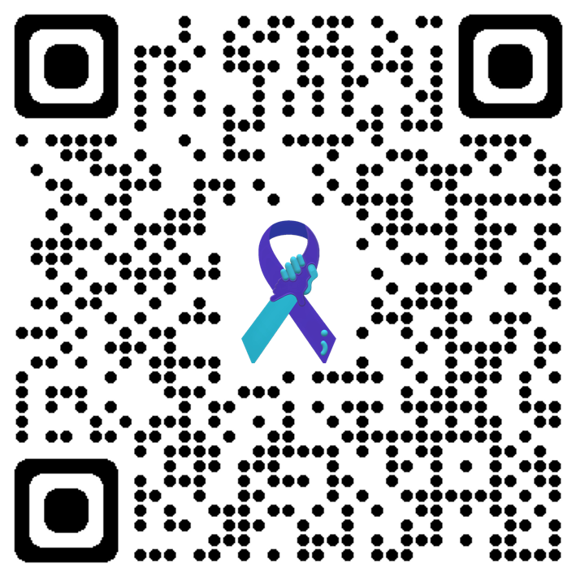
September 28th | YAP at CCBC
Coming soon to the Youth Ambassador Program SOC Webpage:
https://www.bc-systemofcare.org/youth-ambassador-program/
New
Student Resources
New
School & Teacher Resources

Slide 8
View/Print/Share the Flyer and Register:
https://www.bc-systemofcare.org/beaver-county-safe-schools-symposium/

Slide 10
View/Print/Share the Flyer and Register:
https://www.bc-systemofcare.org/training-for-faith-based-leaders-and-community-members-soul-shop/

Slide 11
The Department of Human Services’ (DHS) Office of Mental Health & Substance Abuse Services (OMHSAS) and the Office of Developmental Programs (ODP) host a quarterly Statewide Positive Approaches & Practices Meeting. This meeting aims to provide the most recent research and resources for people with mental health and behavioral challenges, intellectual disabilities, autism, and other developmental disabilities to live an everyday life.
DATE: Friday, October 21, 2022
Time: 9:00 am - 3:00 pm
TOPIC: SUICIDE PREVENTION AND INTERVENTION
TO REGISTER: https://attendee.gotowebinar.com/register/8862704061282919181
Please see the attached .pdf for additional information and agenda for the 10/21/22 meeting.
If you have questions or concerns related to the upcoming meeting, please e-mail Karen Orner at klorner@columbusorg.com.
View/Print/Share
https://www.bc-systemofcare.org/statewide-positive-approaches-practices-meeting/

Slide 12
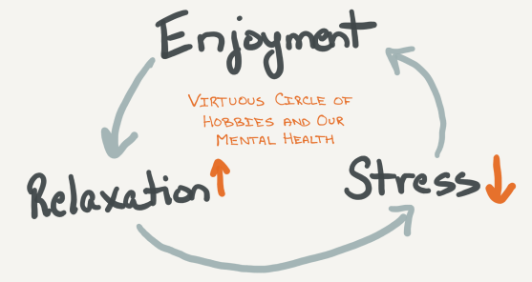
Details & Vendor Info:
https://www.bc-systemofcare.org/hobbies-for-healing-november-12th/
Hobbies for Healing
A toy & hobby show to highlight the importance of enjoying hobbies and outlets to help with positive mental wellness.
Event will be held at the Beaver Valley Church of God on
Saturday, November 12th from 10am until 4pm.
Admission is FREE
Please come and browse the various vendors
Featuring:
Vintage Toys
Holiday Crafts
Model Kits
Trains
Refreshments will be available!
Join us on a journey of wellness and recreation!
Hobbies for Healing
Beaver Valley Church of God
1013 Beaner Hollow Road
Beaver, PA 15009

Slide 13
SEPTEMBER IS NATIONAL SUICIDE PREVENTION MONTH
The week of September 4th-10th is recognized as National Suicide Prevention Week
Saturday, September 10th marking World Suicide Prevention Day.
This year’s theme is “Creating Hope through Action.”
A community resource guide is available at Jana Marie Foundation: https://janamariefoundation.org/engage/programs/suicide-prevention-month/

Slide 14
honoring individuals in recovery from Drug & Alcohol use disorder!
members of the recovery community!
family & friends!
health care professionals!
resources!
activities for everyone!
Register by using the QR Code or visit:
www.bc-systemofcare.org/save-the-date-2nd-annual-beaver-county-recovery-walk-9-24-22/

Slide 15
VA’s Last Session of Suicide Prevention Month Lecture Series
Hosted by the VA Pittsburgh Suicide Prevention Team, this suicide prevention topic will be explored and discussed using the Teams platform.
Feel free to share with anyone who may be interested.
VA Employees (ASWB, APA) are eligible for 1 CEU for participation at each session (a total of 4 CEUs). Please register prior to the event on TMS, attendance will be taken from Teams.
September 27th - Recognizing Risk of Suicide & Responding to it in the Older Adult Population
www.bc-systemofcare.org/the-va-is-offering-a-suicide-prevention-month-lecture-series/

Slide 16
2022 Fall Training Series
The GLS grant team is excited to announce another round of virtual suicide prevention webinars. See the flyer below for more information on the dates and times of the trainings being offered. To view more detailed information and to register, click here. Please feel free to share this with anyone who may be interested.

Slide 17
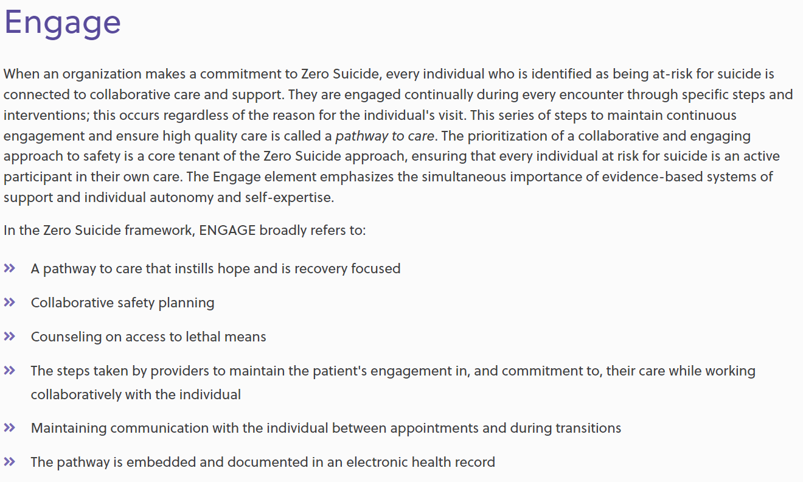
Garrett Lee Smith Youth Suicide Prevention Grant
Held on September 15th
Focused on the essential element: Engage
Next meeting October 20th at 12pm

Slide 18
Other Updates

Slide 19
THANK YOU!!!
126 in attendance
Feedback from the surveys

Slide 20
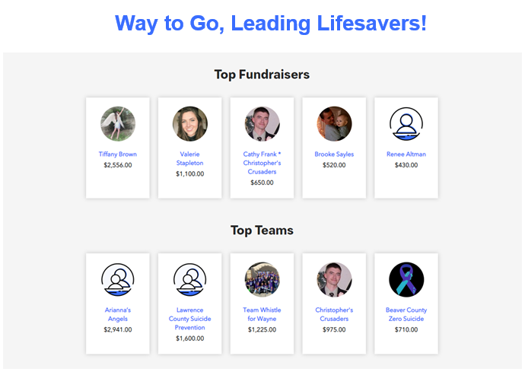
AFSP- Out of the Darkness Walk
Thank you!!!!
Beaver County raised $718

Slide 21
Help for Pennsylvania Farmers
The Beaver County System of Care Website has Graphics and Social Media Content for sharing.
https://www.bc-systemofcare.org/agristress-helpline-for-pennsylvania/

Slide 22
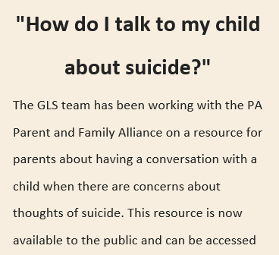
How Do I Talk to My Child About Suicide? (paparentandfamilyalliance.org)

Slide 23
Suicide Awareness and Prevention | PA Parent and Family (paparentandfamilyalliance.org)

Slide 24
TRAININGS

Slide 25
First Presbyterian Church of Beaver is offering a FREE MHFA training!
For registration and details, visit the Beaver County System of Care Web Announcement:
www.bc-systemofcare.org/free-mental-health-first-aid-trainings/
or visit
www.bc-systemofcare.org/training/

Slide 26
Beaver County Behavioral Health is pleased to sponsor this event!
For registration and details, visit the Beaver County System of Care Web Announcement:
www.bc-systemofcare.org/free-mental-health-first-aid-trainings/
or visit
www.bc-systemofcare.org/training/

Slide 27
Trainings Available
QPR (Question, Persuade, and Refer)
Virtual or In-person
Youth QPR (Question, Persuade, and Refer)
Virtual or In-person
Mental Health First Aid
Youth Mental Health First Aid
Archived trainings:
BC SOC Youtube:
https://www.youtube.com/channel/UCDKZZQif0q0YIqfBgkEGc4Q
Beacon:
https://www.beaconhealthoptions.com/providers/beacon/important-tools/webinars/archive/
Prevent Suicide PA:
https://www.preventsuicidepa.org/trainings/all-trainings/
www.bc-systemofcare.org/training/

Slide 28
Next meeting
Date: October 28th at 1:30pm
Zoom link will be sent

Slide 29
NAMI Helpline Launches New Nationwide Texting Support Option
https://www.nami.org/help
(Chat box at bottom of the webpage)
The NAMI HelpLine can be reached Monday through Friday, 10 a.m. – 10 p.m., ET.
Call 1-800-950-NAMI (6264) Text "HelpLine" to 62640 … or email us at helpline@nami.org
https://www.bc-systemofcare.org/nami-helpline-launches-new-nationwide-texting-support-option/

Slide 30
Check out the website: http://www.bc-systemofcare.org/ Send updates to: SOCwebmaster@ahci.org SOC YouTube channel: https://www.youtube.com/watch?v=GY4rLQJRAcM&list=PL6lF8gWeCfKyHgu4A5RKl1SX7kH2BJrC-&index=2

Slide 32
Resources
Please share the following resources with anyone who can benefit

Slide 33
Food Resources
https://www.agriculture.pa.gov/Food_Security/Pages/Resources.aspx
Mental Health Resources
https://www.pa.gov/guides/mental-health/
Unemployment Benefits
https://www.pa.gov/guides/unemployment-benefits/
COVID Testing
https://pema.maps.arcgis.com/apps/webappviewer/index.html?id=1a4c139769d646839e1549bcb6a668f1
COVID Guidance and Resources
https://www.pa.gov/guides/responding-to-covid-19/
Help for Homeowners / Landlords / Renters
https://www.consumerfinance.gov/coronavirus/mortgage-and-housing-assistance/renter-protections/find-help-with-rent-and-utilities/?utm_source=vanity&utm_medium=outreach&utm_campaign=renthelp
PA COVID Resources

Slide 34
Resources
The Mental Health Support Line
Developed on April 1st
Can be reached toll-free, 24/7 at 1-855-284-2494 from anywhere in PA.
Crisis Text Line
Text PA to 741-741
PA Get Help Now Helpline
Can be reached toll-free at 1-800-662-HELP (4357).
A live chat option is also available online or via text message at 717-216-0905
Warmline of Beaver County
Can be reached at 1-877-775-WARM (9276)
Hours of operation 6pm-9pm
UPMC Beaver County Crisis
Can be reached toll-free, 24/7 at 1-800-400-6180

Slide 35
PA Resources
Many other resources also remain available to Pennsylvanians in need of support, including:
National Suicide Prevention Lifeline: 1-800-273-TALK (8255)
Línea Nacional de Prevención del Suicidio: 1-888-628-9454
Crisis Text Line: Text “PA” to 741-741
Safe2Say: 1-844-723-2729 or www.safe2saypa.org
Veteran Crisis Line: 1-800-273-TALK (8255) (Press 1)
Disaster Distress Helpline: 1-800-985-5990
Get Help Now Hotline (for substance use disorders):
1-800-662-4357

Slide 36
What can we do to help?
E-mail us:
Elisia Majors
emajors@bcbh.org
Stephanie Santoro
ssantoro@ahci.org
Bonnie Palmieri
bpalmieri@ahci.org

Slide 37
Thank you!! Stay Well!

