Slide 1
Incident Management
12/01/2022

Slide 2
Reminder
Why do we report in Beaver County?
Continuous Quality Improvement
Identification of trends and/or improvement opportunities
prevent future incidents
Improve system functioning
Monitoring to ensure member safety and high quality services
increase opportunities for intervention
Because it is required.

Slide 3
Two Reporting Methods*
Beacon members | Non Beacon members
Reporting to Beacon Health Options remains the same and the Beacon Reportable Events training can be viewed by going to:
https://www.bc-systemofcare.org/wp-content/uploads/2022/11/Reportable-Events-Training.pdf

Slide 4
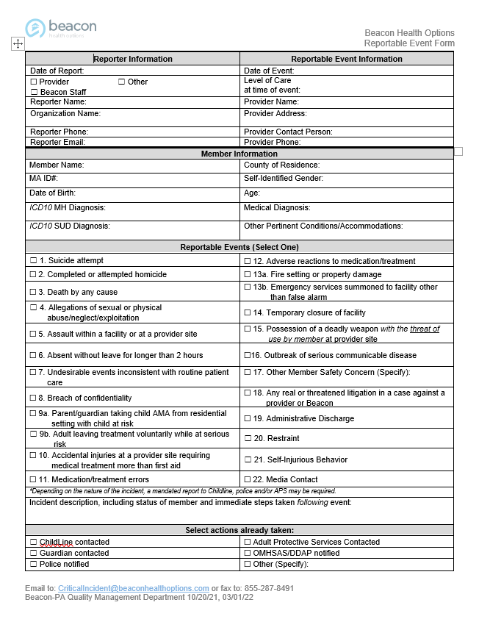
Beacon Members
When and How Do You Submit a Reportable Event?
When do I report?
Within one (1) business day from the event date
How do I report?
Reportable Event Form located under Quality Management Forms at: https://pa.beaconhealthoptions.com/providers/provider-forms/
Risk Management Email: CriticalIncident@beaconhealthoptions.com
Risk Management Fax:
1-855-287-8491 attention: Critical Incidents

Slide 5
Non Beacon members
Type incident information into new reporting form
Send via secure email
Include Incident.type in the subject line
Examples: Incident.Arrest
Incident.AMA
To the attention of
Elisia Majors
emajors@bcbh.org
Matt Stahoviak
mstahoviak@bcbh.org
FAX: 724-847-6229

Slide 6
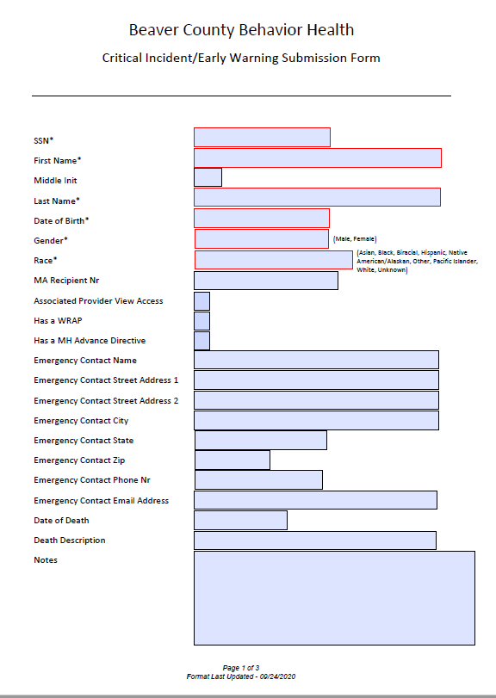
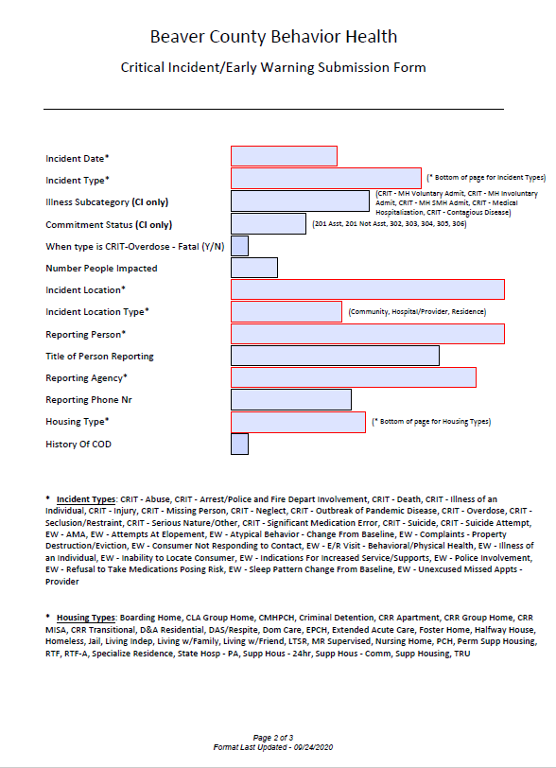
Reporting Form

Slide 7
Any questions?
Elisia Majors
emajors@bcbh.org
Matt Stahoviak
mstahoviak@bcbh.org

